Slide 1
Covid Data Analysis in AWS
Umakant Yadav

Slide 2
OBJECTIVE
To perform data analysis and visualization on Covid-19 data using ETL tools.
To perform data analysis on Covid_19 data and extract the meaningful information from the dataset which will help in taking quick and informed decision.

Slide 3
TECHNOLOGIES USED
AWS Glue
SparkSQL
Redshift
AWS S3
SparkSQL
Crawler
AWS Lambda
PySpark

Slide 4
SCHEMA REPRESENTATION
Covid_19_India
iso_code
continent
country
date
total_cases
new_cases
total_deaths
new_deaths
new_tests
IndividualDetails
total_tests
positive_rate
age
gender
population
median_age
male_smokers
female_smokers
diabetes_prevalence
status_change_date
notes

Slide 5
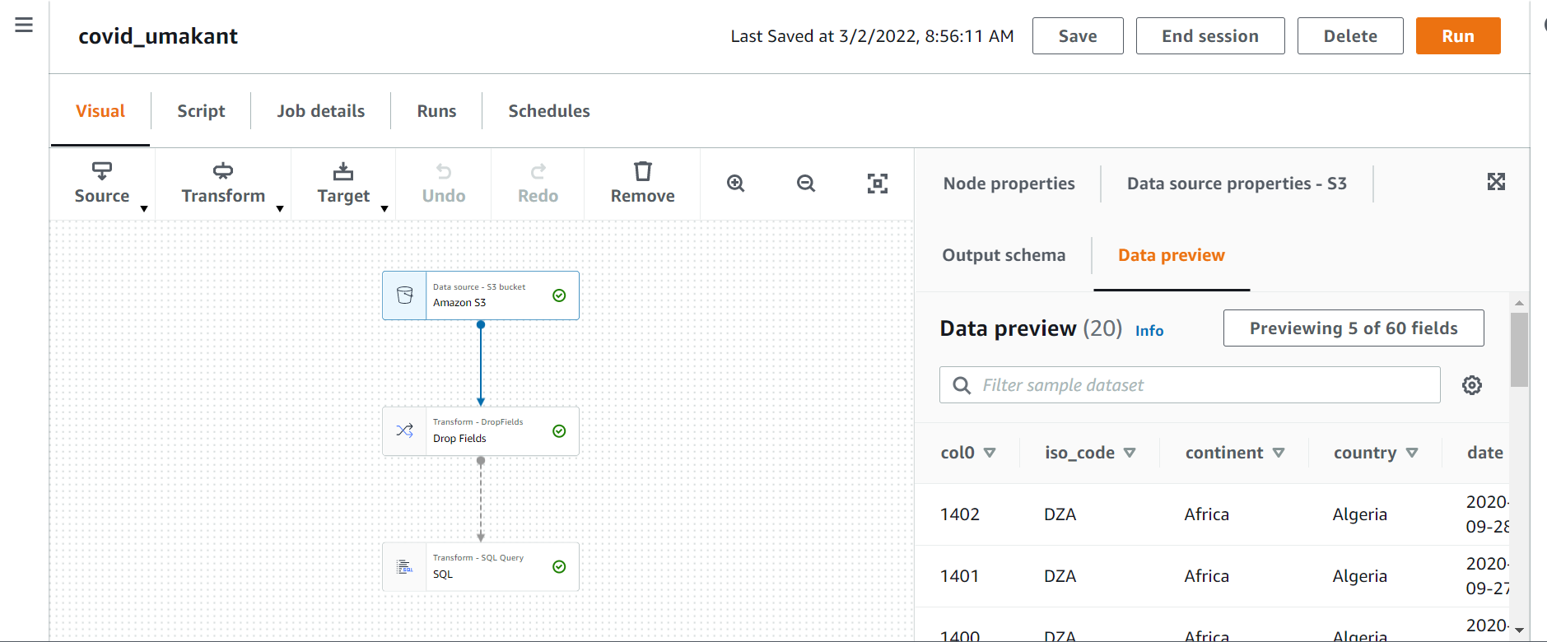
Problem Statements 1.Clean and transform data for processing select * from covid_19 where Sno != ‘’

Slide 6
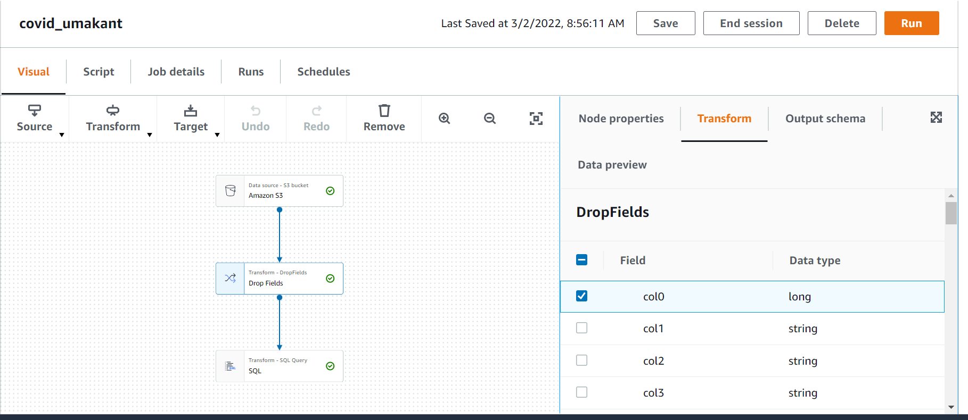
2. ETL operations on dataset

Slide 7
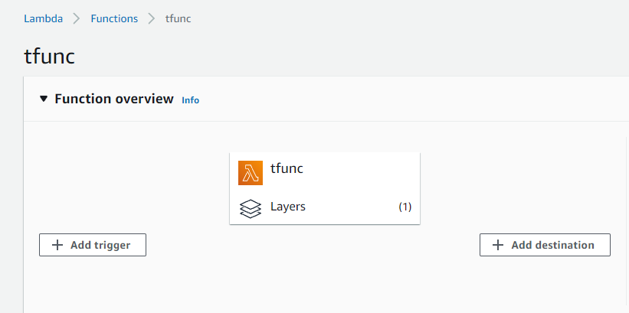
3. Storing the modified data in AWS

Slide 8
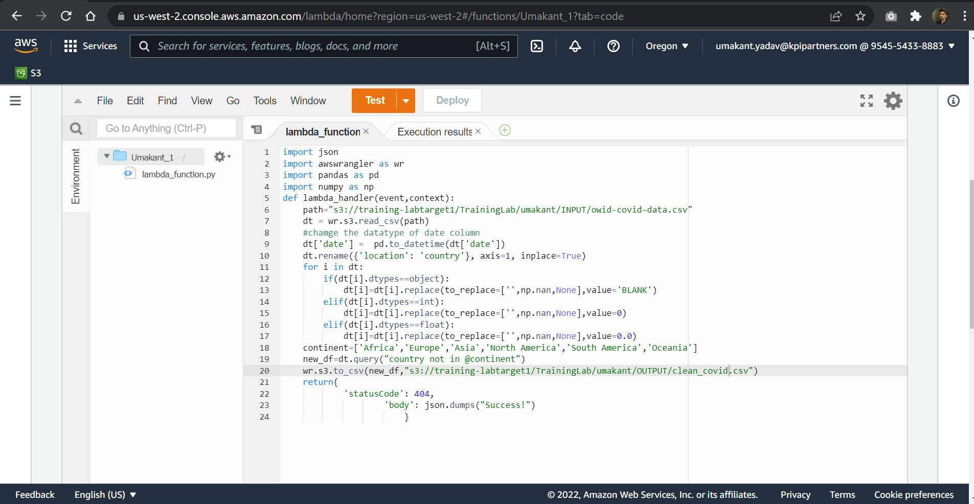
3. Storing the modified data in AWS Cont…

Slide 9
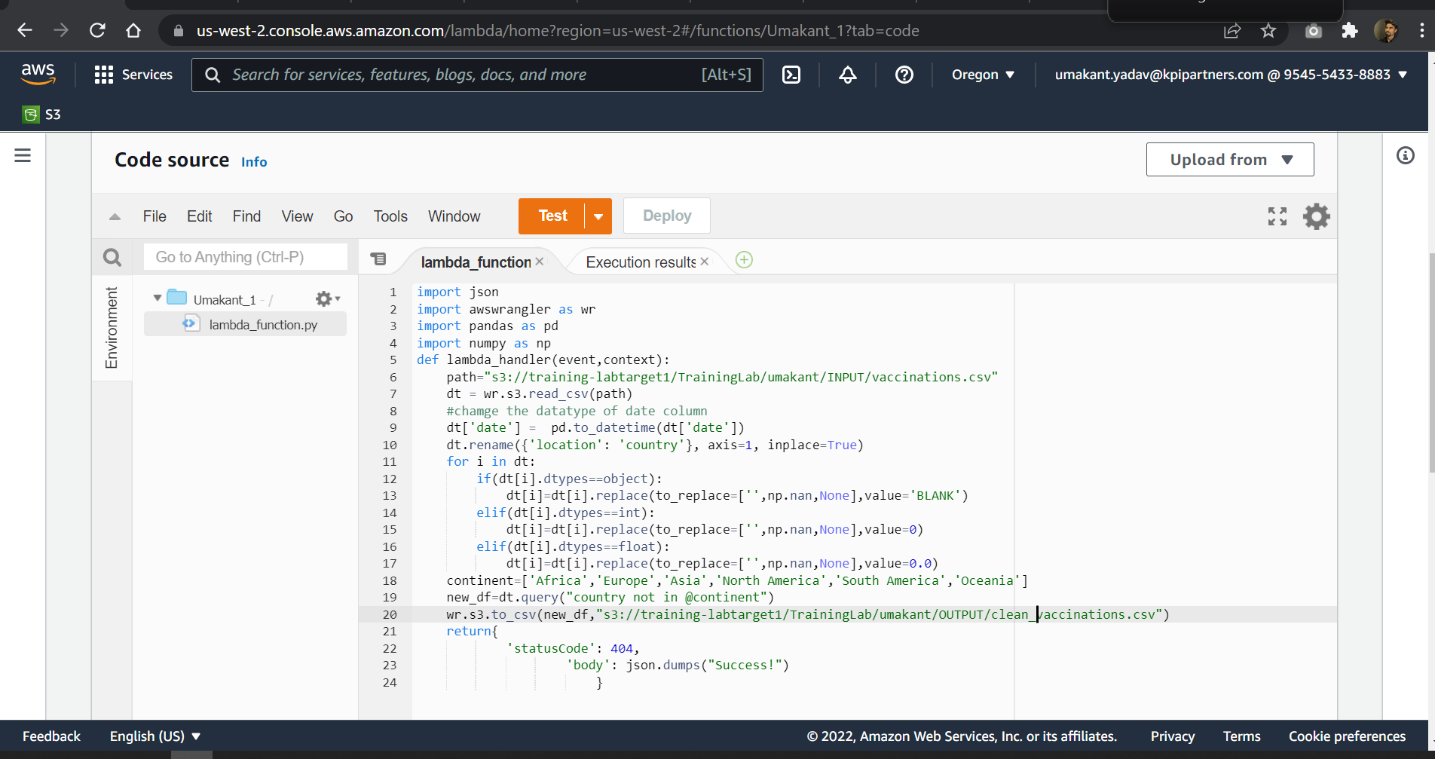
3. Storing the modified data in AWS Cont…

Slide 10
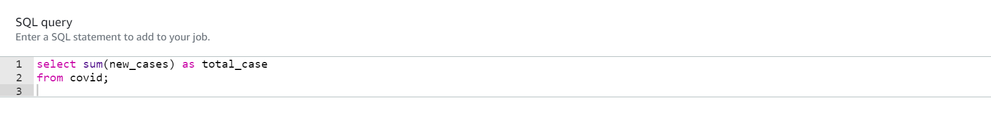
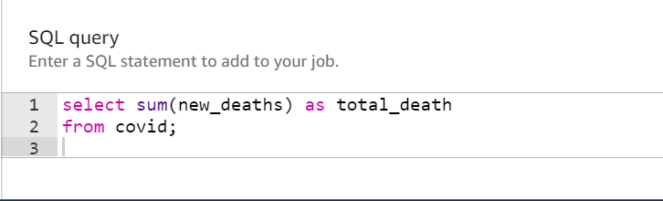
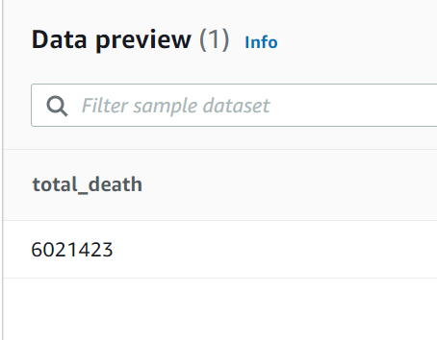
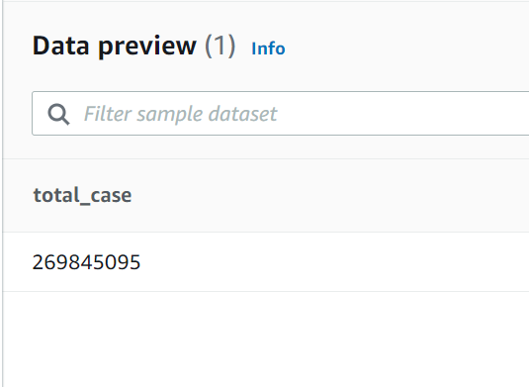
4.Display total cases ,new cases , recovered cases and deaths Cont…

Slide 11
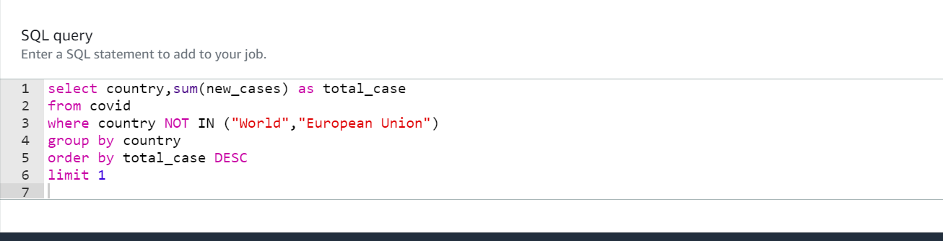
5. Which country in Distinct WHO region highest cases in till date.

Slide 12
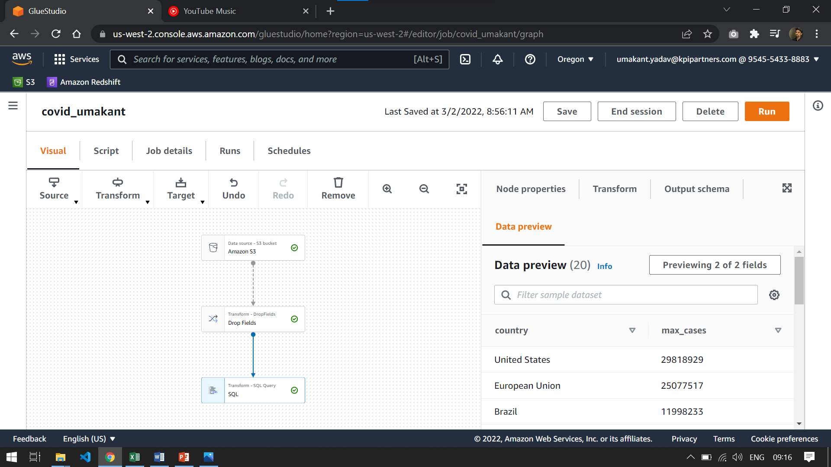
5.Which country in Distinct WHO region highest cases in till date Cont…

Slide 13
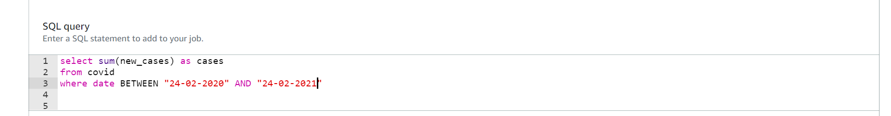
6. Total no of confirmed cases over between a certain date.

Slide 14
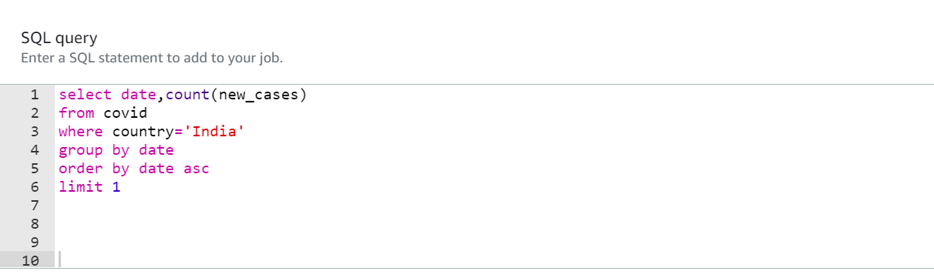
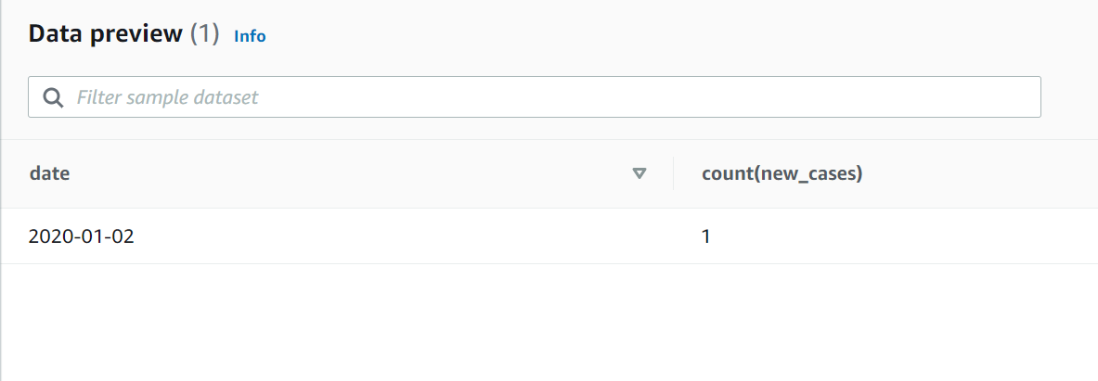
8.Date of first confirmed case in a particular region.

Slide 15
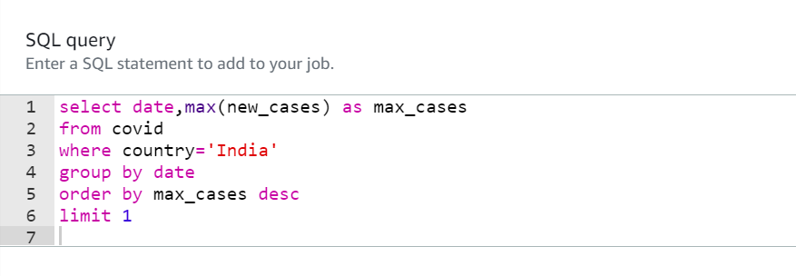
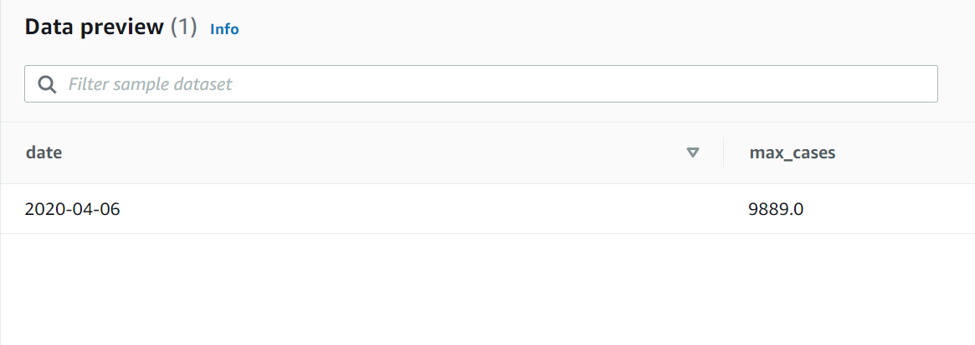
9.Date on which max no. cases were reported in a country.

Slide 16
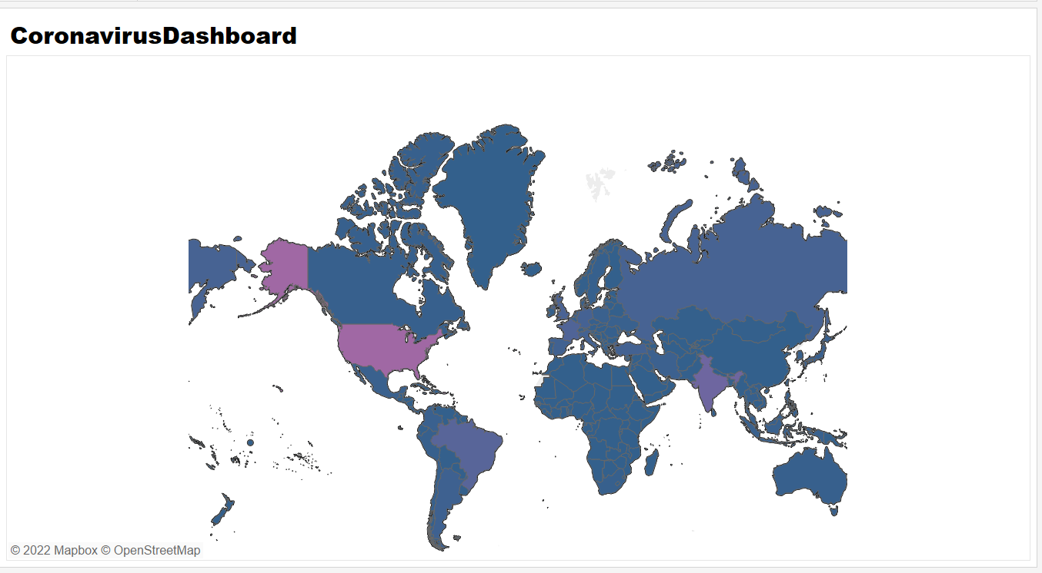
Visualization in Redshift-

Slide 17
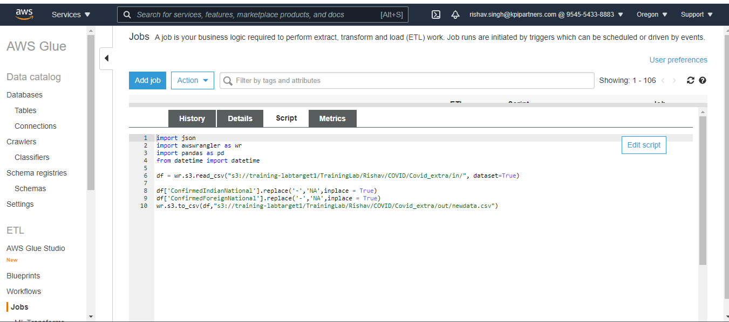
Creating Glue Job and Executing Transformation using PySpark Cont…

Slide 18
THANK YOU

